Slide 1
Java Programming
Java Programming IT-11

Slide 2
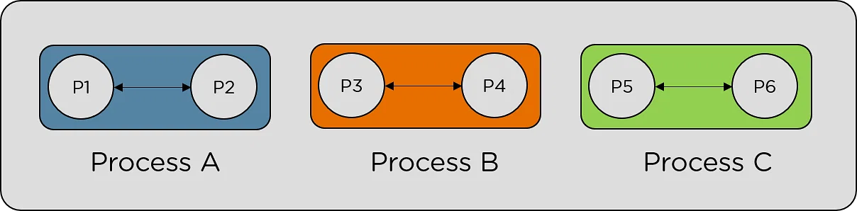
What is a Thread in Java?
A thread is the smallest segment of an entire process. A thread is an independent, virtual and sequential control flow within a process. In process execution, it involves a collection of threads, and each thread shares the same memory. Each thread performs the job independently of another thread

Slide 3
Multithreading in Java
Multithreading in Java is a process of executing multiple threads simultaneously.
A thread is a lightweight sub-process, the smallest unit of processing. Multiprocessing and multithreading, both are used to achieve multitasking.
However, we use multithreading than multiprocessing because threads use a shared memory area. They don't allocate separate memory area so saves memory, and context-switching between the threads takes less time than process.
Java Multithreading is mostly used in games, animation, etc.

Slide 4
What is the Use of Multi-Thread in Java?
Because each Thread is managed individually and several operations can be carried out at once, the user is not blocked.
It is used to save time as multiple operations are performed concurrently.
Since threads are independent, other threads don’t get affected even if an exception occurs in a single thread.

Slide 5
Lifecycle of a Thread in Java
The lifecycle of each thread in Java has five different stages. The Stages of the Lifecycle are mentioned below.
New
Runnable
Running
Waiting
Dead

Slide 6
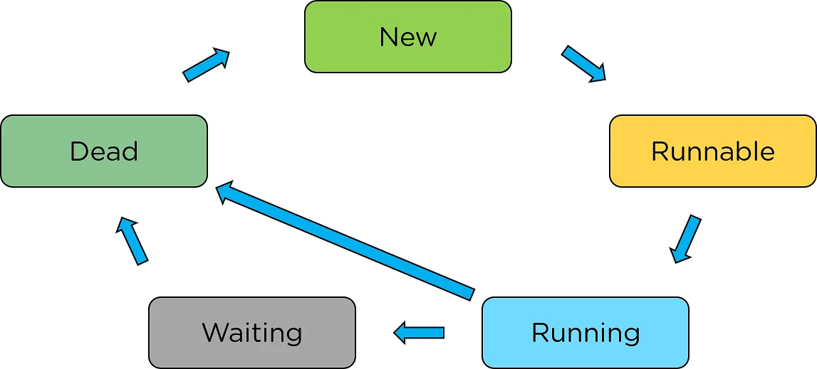
Lifecycle of a Thread in Java

Slide 7
Lifecycle of a Thread in Java
New:
The first stage is "New".
This stage is where it initiates the thread. After that, every thread remains in the new state until the thread gets assigned to a new task.
Runnable:
The next stage is the runnable stage.
Here, a thread gets assigned to the task and sets itself for running the task.
Running:
The third stage is the execution stage.
Here, the thread gets triggered as control enters the thread, and the thread performs a task and continues the execution until it finishes the job.

Slide 8
Lifecycle of a Thread in Java
Waiting:
At times, there is a possibility that one process as a whole might depend on another. During such an encounter, the thread might halt for an intermediate result because of its dependency on a different process. This stage is called the Waiting Stage.
Dead:
The final stage of the process execution with Multithreading in Java is thread termination. After it terminates the process, the JVM automatically declares the thread dead and terminates the thread. This stage is known as the dead thread stage.

Slide 9
Methods of Multithreading in Java
The following are methods used for Multithreading in Java.
void start():
Causes the Thread to begin execution.
void run():
Utilised to carry out a thread's action.
long getId():
Returns the identifier of the thread
final String getName():
Returns the threads name

Slide 10
Methods of Multithreading in Java
final void setName(String name):
Sets the name of the thread
final int getPriority():
Returns thread’s priority
final void setPriority(int newPriority):
Changes the priority if the thread
boolean isAlive():
It checks to see if the Thread is alive.
void suspend():
It is used to suspend the Thread.
void resume():
The suspended Thread is resumed using it.

Slide 11
Methods of Multithreading in Java
void stop():
The Thread is stopped using it.
void destroy():
The thread group and all of its subgroups are destroyed using it.
static void yield():
A hint to the scheduler that the current Thread is willing to yield its current use of a processor.
void notify():
It is used to give the notification for only one Thread that is waiting for a particular object.
void notifyAll():
It is used to give notification to all waiting threads of a particular object.

Slide 12
Thread Priorities
Every Java thread has a priority that helps the operating system determine the order in which threads are scheduled.
Java thread priorities are in the range between MIN_PRIORITY (a constant of 1) and MAX_PRIORITY (a constant of 10). By default, every thread is given priority NORM_PRIORITY (a constant of 5).
Threads with higher priority are more important to a program and should be allocated processor time before lower-priority threads. However, thread priorities cannot guarantee the order in which threads execute and are very much platform dependent

Slide 13
Creating Thread
Threads can be created by using two mechanisms :
Extending the Thread class
Implementing the Runnable Interface
Create a Thread by Extending a Thread Class:
The First way to create a thread is to create a new class that extends Thread class using the following two simple steps.
This approach provides more flexibility in handling multiple threads created using available methods in Thread class.

Slide 14
Create a Thread by Extending a Thread Class:
Step 1
You will need to override run( ) method available in Thread class.
This method provides an entry point for the thread and you will put your complete business logic inside this method.
Following is a simple syntax of run() method −
public void run( )

Slide 15
Create a Thread by Extending a Thread Class:
Step 2
Once Thread object is created, you can start it by calling start() method, which executes a call to run( ) method.
Following is a simple syntax of start() method −
void start( );

Slide 16
Example
class ThreadDemo extends Thread {
private Thread t;
private String threadName;
ThreadDemo( String name) {
threadName = name;
System.out.println("Creating " + threadName );
}

Slide 17
Example
public void run() {
System.out.println("Running " + threadName );
try {
for(int i = 4; i > 0; i--) {
System.out.println("Thread: " + threadName + ", " + i);
Thread.sleep(50);
}
} catch (InterruptedException e) {
System.out.println("Thread " + threadName + " interrupted.");
}
System.out.println("Thread " + threadName + " exiting.");
}

Slide 18
Example
public void start () {
System.out.println("Starting " + threadName );
if (t == null) {
t = new Thread (this, threadName);
t.start ();
}
}
}
public class TestThread {
public static void main(String args[]) {
ThreadDemo T1 = new ThreadDemo( "Thread-1");
T1.start();
ThreadDemo T2 = new ThreadDemo( "Thread-2");
T2.start();
}
}

Slide 19
Output
Creating Thread-1
Starting Thread-1
Creating Thread-2
Starting Thread-2
Running Thread-1
Thread: Thread-1, 4
Running Thread-2
Thread: Thread-2, 4
Thread: Thread-1, 3
Thread: Thread-2, 3
Thread: Thread-1, 2
Thread: Thread-2, 2
Thread: Thread-1, 1
Thread: Thread-2, 1
Thread Thread-1 exiting.
Thread Thread-2 exiting.

Slide 20
Thread by Implementing a Runnable Interface
If your class is intended to be executed as a thread then you can achieve this by implementing a Runnable interface.
You will need to follow three basic steps −
Step 1
As a first step, you need to implement a run() method provided by a Runnable interface.
This method provides an entry point for the thread and you will put your complete business logic inside this method.
Following is a simple syntax of the run() method −
public void run( )

Slide 21
Thread by Implementing a Runnable Interface
Step 2
As a second step, you will instantiate a Thread object using the following constructor −
Thread(Runnable threadObj, String threadName);
Where, threadObj is an instance of a class that implements the Runnable interface and threadName is the name given to the new thread

Slide 22
Thread by Implementing a Runnable Interface
Step 3
Once a Thread object is created, you can start it by calling start() method, which executes a call to run( ) method.
Following is a simple syntax of start() method −
void start();

Slide 23
Example
class RunnableDemo implements Runnable {
private Thread t;
private String threadName;
RunnableDemo( String name) {
threadName = name;
System.out.println("Creating " + threadName );
}

Slide 24
Example
public void run() {
System.out.println("Running " + threadName );
try {
for(int i = 4; i > 0; i--) {
System.out.println("Thread: " + threadName + ", " + i);
Thread.sleep(50);
}
} catch (InterruptedException e) {
System.out.println("Thread " + threadName + " interrupted.");
}
System.out.println("Thread " + threadName + " exiting.");
}

Slide 25
Example
public void start () {
System.out.println("Starting " + threadName );
if (t == null) {
t = new Thread (this, threadName);
t.start ();
}
}
}

Slide 26
Example
public class TestThread {
public static void main(String args[]) {
RunnableDemo R1 = new RunnableDemo( "Thread-1");
R1.start();
RunnableDemo R2 = new RunnableDemo( "Thread-2");
R2.start();
}
}

Slide 27
Output
Creating Thread-1
Starting Thread-1
Creating Thread-2
Starting Thread-2
Running Thread-1
Thread: Thread-1, 4
Running Thread-2
Thread: Thread-2, 4
Thread: Thread-1, 3
Thread: Thread-2, 3
Thread: Thread-1, 2
Thread: Thread-2, 2
Thread: Thread-1, 1
Thread: Thread-2, 1
Thread Thread-1 exiting.
Thread Thread-2 exiting.

Slide 28
What is the yield() method
In simple terms, the meaning of ‘yield’ is “to give up” or “to surrender”.
The yield() method gives the hint to the thread scheduler that the current running thread is not doing something too critical and provides a chance for other waiting threads of the same priority for their execution.
The thread scheduler can ignore the hint or can take action also
thread.yield()

Slide 29
What is the yield() method
When JVM executes the above line, it gives the hint to the thread scheduler that if CPU is not executing anything important and any other thread is RUNNABLE state then other threads should be run.

Slide 30
A real-life example of the yield() method
Let’s say we have two threads, which are thread1, thread2, and both threads have the same priority.
Thread1 uses the processor time and it is in a running state. The thread2 is in a RUNNABLE state.
The completion time of thread1 is 1 hour and the completion time of thread2 is 5 minutes.
So thread2 must wait for 1 hour to just finish the 5-minute job.
In such types of scenarios where one thread is taking too much time to complete its execution and other important threads are waiting.
Here can use the yield() method and give the chance to execute the other threads.

Slide 31
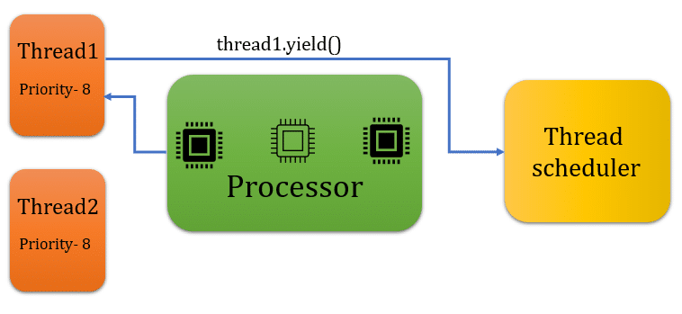
A real-life example of the yield() method

Slide 32
A real-life example of the yield() method
class ThreadOne extends Thread
{
public void run()
{
for(int i=1;i<=5;i++)
{
System.out.println("Thread one is running");
Thread.yield();
}
}
}

Slide 33
A real-life example of the yield() method
class ThreadTwo extends Thread
{
public void run()
{
for(int i=1;i<=5;i++)
{
System.out.println("Thread two is running");
}
}
}

Slide 34
A real-life example of the yield() method
class MainThread
{
public static void main(String args[])
{
ThreadOne threadOne = new ThreadOne();
ThreadTwo threadTwo = new ThreadTwo();
threadOne.start();
threadTwo.start();
}
}

Slide 35
A real-life example of the yield() method
Output: Thread one is running Thread two is running Thread two is running Thread two is running Thread two is running Thread two is running Thread one is running Thread one is running Thread one is running Thread one is running

Slide 36
Synchronizing Threads
Multi-threaded programs may regularly come up with a situation where multiple Java threads attempt to get to the same resource which produces fraudulent and startling outcomes.
At times, more than one thread might try to access a shared resource, you need to ensure that resource will be used by only one thread at a time. This can be done using Synchronization in Java.
To avoid these kinds of bugs, methods like Wait and Notify in Java are introduced.

Slide 37
wait(), notify() and notifyAll() methods
Wait()
This method causes the thread to wait until another thread invokes notify() and notifyAll() methods for this object.
This Wait() method tells the calling thread to let go of a lock and go to sleep until some other thread enters the same monitor and calls to notify().
This method releases the lock before waiting and reacquires the lock before returning from the wait() method.
public final void wait() throws InterruptedException

Slide 38
wait(), notify() and notifyAll() methods
notify()
This method is used to notify the threads that it needs to function.
It wakes up one thread that called the wait() method on the same object.
public final void notify()
notifyAll() :
The notifyAll() method wakes up all threads that are waiting on that object’s monitor.
public final void notifyAll()

Slide 39
wait(), notify() and notifyAll() methods
Note: Wait and Notify methods are defined in the object class, and they must be called inside synchronized block.
Example:
public class Thread1
{
public static void main(String[] args)
{
Thread2 b = new Thread2();
b.start();

Slide 40
Example:
synchronized(b)
{
try
{
System.out.println("Waiting for 2 to complete...");
b.wait();
}
catch(InterruptedException e)
{
e.printStackTrace();
}
System.out.println("Total is: " + b.total);
} } }

Slide 41
Example:
class Thread2 extends Thread1
{
int total;
@Override public void run()
{
synchronized(this)
{
for(int i=0; i<=100 ; i++)
{
total += i;
}
notify();
}}}

Slide 42

Deadlock in Java
Deadlock in Java is a part of multithreading. Deadlock can occur in a situation when a thread is waiting for an object lock, that is acquired by another thread and second thread is waiting for an object lock that is acquired by first thread. Since, both threads are waiting for each other to release the lock, the condition is called deadlock.

Slide 43
Example of Deadlock in Java
public class TestDeadlockExample1 {
public static void main(String[] args) {
final String resource1 = "ratan jaiswal";
final String resource2 = "vimal jaiswal";
// t1 tries to lock resource1 then resource2
Thread t1 = new Thread() {
public void run() {
synchronized (resource1) {
System.out.println("Thread 1: locked resource 1");

Slide 44
Example of Deadlock in Java
try
{
Thread.sleep(100);
}
catch (Exception e)
{}
synchronized (resource2)
{
System.out.println("Thread 1: locked resource 2");
}
}
}
};

Slide 45
Example of Deadlock in Java
// t2 tries to lock resource2 then resource1
Thread t2 = new Thread() {
public void run() {
synchronized (resource2) {
System.out.println("Thread 2: locked resource 2");
try {
Thread.sleep(100);
}
catch (Exception e) {}

Slide 46
Example of Deadlock in Java
synchronized (resource1) {
System.out.println("Thread 2: locked resource 1");
}
}
}
};
t1.start();
t2.start();
}
}

Slide 47
Output:
Thread 1: locked resource 1
Thread 2: locked resource 2

